Slide 1

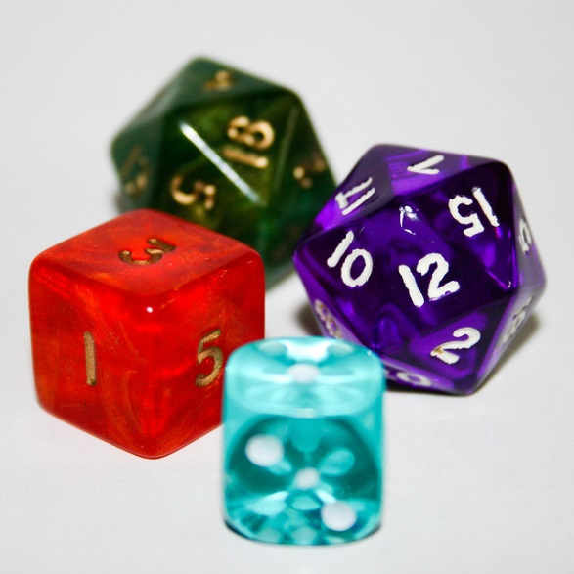

My Probability Interactive Notebook
Name
Class
Teacher Mr Evans
Term 2 Semester 1
1

Slide 2
Create your own front page
It needs to contain the following –
My number interactive notebook
Name
Class
Teachers Name
Semester 1 Term 1
Page number 1

Slide 3
Contents
Glossary or Formula Page
Page
Date
Description
2
3

Slide 4
Tasks
24
7
30
Essential Question
Questions
Notes
Summary
4
5

Slide 5
24
7
30
Date
Probability Revision
EQ – Describe how a sample space is used to calculate the probability of an even happening.
5

Slide 6
24
7
30
Date
Probability Revision
EQ – Describe how a sample space is used to calculate the probability of an even happening.
Probability describes the chance of an event happening.
5

Slide 7
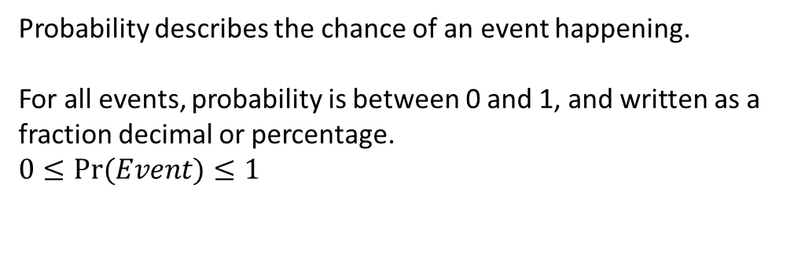
24
7
30
Date
Probability Revision
EQ – Describe how a sample space is used to calculate the probability of an even happening.
Probability describes the chance of an event happening.
For all events, probability is between 0 and 1, and written as a fraction decimal or percentage.
$$0≤Pr⁡(Event)≤1$$
5

Slide 8
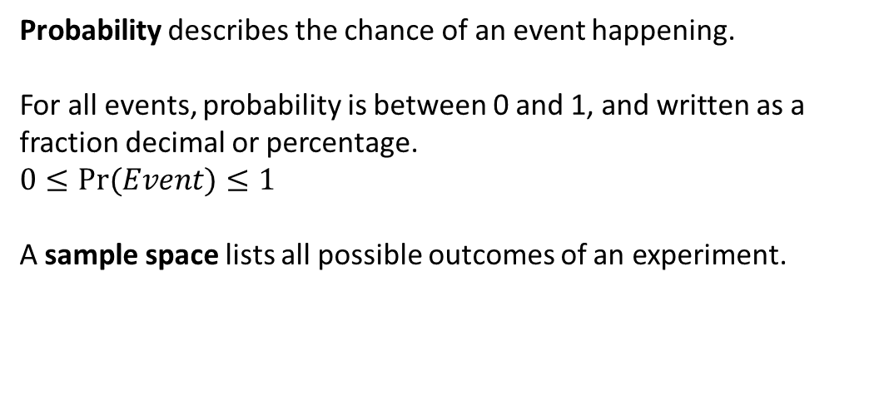
24
7
30
Date
Probability Revision
EQ – Describe how a sample space is used to calculate the probability of an even happening.
Probability describes the chance of an event happening.
For all events, probability is between 0 and 1, and written as a fraction decimal or percentage.
$$0≤Pr⁡(Event)≤1$$
A sample space lists all possible outcomes of an experiment.
5

Slide 9
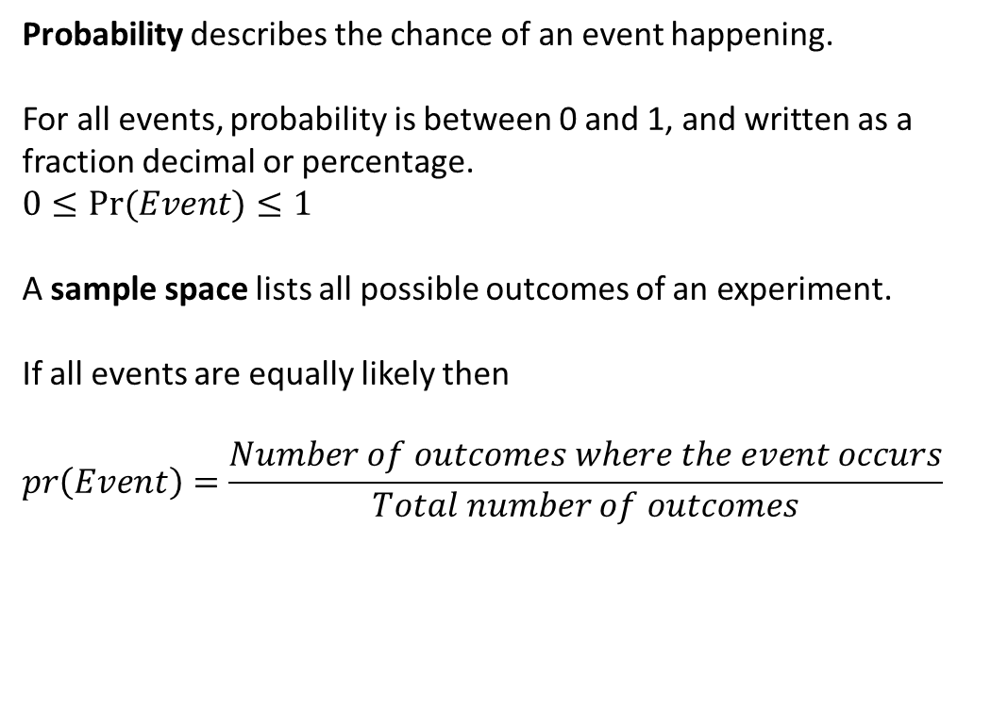
24
7
30
Date
Probability Revision
EQ – Describe how a sample space is used to calculate the probability of an even happening.
Probability describes the chance of an event happening.
For all events, probability is between 0 and 1, and written as a fraction decimal or percentage.
$$0≤Pr⁡(Event)≤1$$
A sample space lists all possible outcomes of an experiment.
If all events are equally likely then
$$pr\left(Event\right)=\frac{Number of outcomes where the event occurs}{Total number of outcomes}$$
5

Slide 10
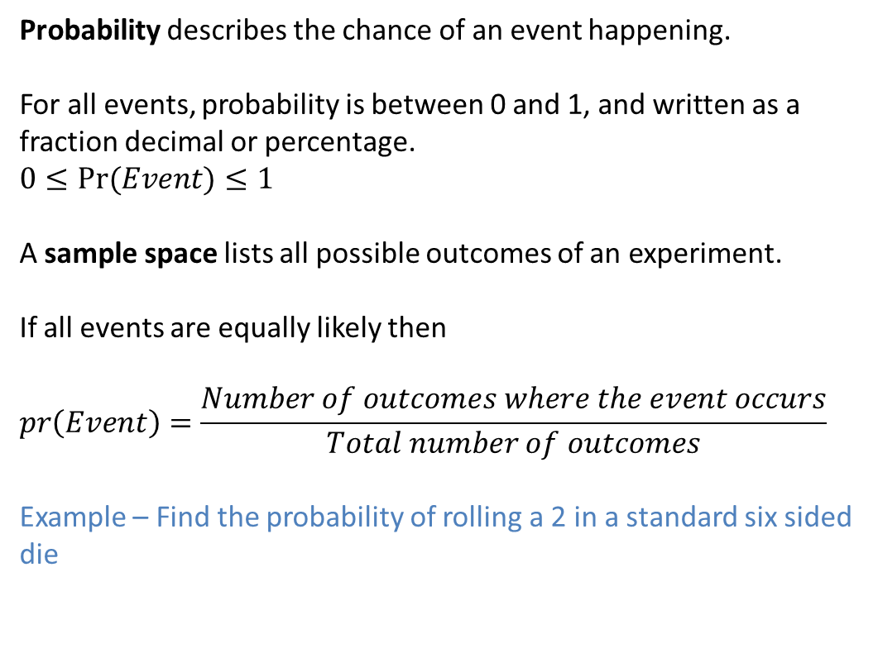
24
7
30
Date
Probability Revision
EQ – Describe how a sample space is used to calculate the probability of an even happening.
Probability describes the chance of an event happening.
For all events, probability is between 0 and 1, and written as a fraction decimal or percentage.
$$0≤Pr⁡(Event)≤1$$
A sample space lists all possible outcomes of an experiment.
If all events are equally likely then
$$pr\left(Event\right)=\frac{Number of outcomes where the event occurs}{Total number of outcomes}$$
Example – Find the probability of rolling a 2 in a standard six sided die
5

Slide 11
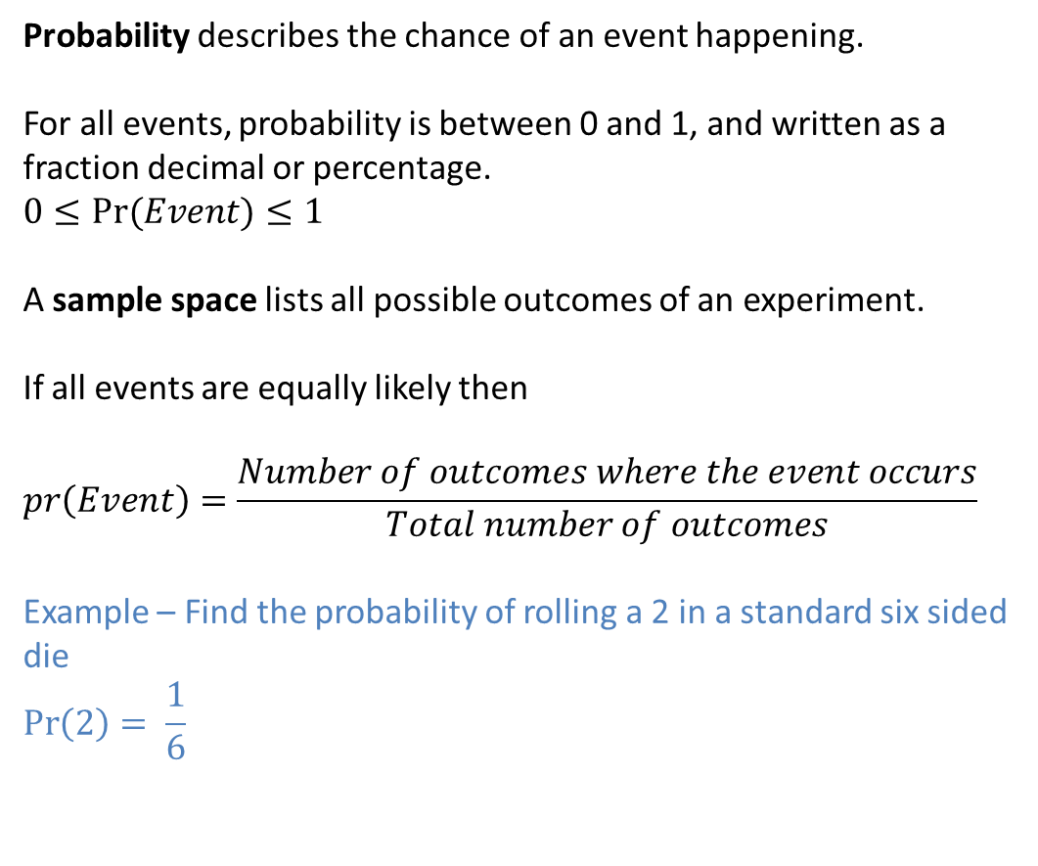
24
7
30
Date
Probability Revision
EQ – Describe how a sample space is used to calculate the probability of an even happening.
Probability describes the chance of an event happening.
For all events, probability is between 0 and 1, and written as a fraction decimal or percentage.
$$0≤Pr⁡(Event)≤1$$
A sample space lists all possible outcomes of an experiment.
If all events are equally likely then
$$pr\left(Event\right)=\frac{Number of outcomes where the event occurs}{Total number of outcomes}$$
Example – Find the probability of rolling a 2 in a standard six sided die
$$\operatorname{Pr}\left(2\right)= \frac{1}{6}$$
5

Slide 12
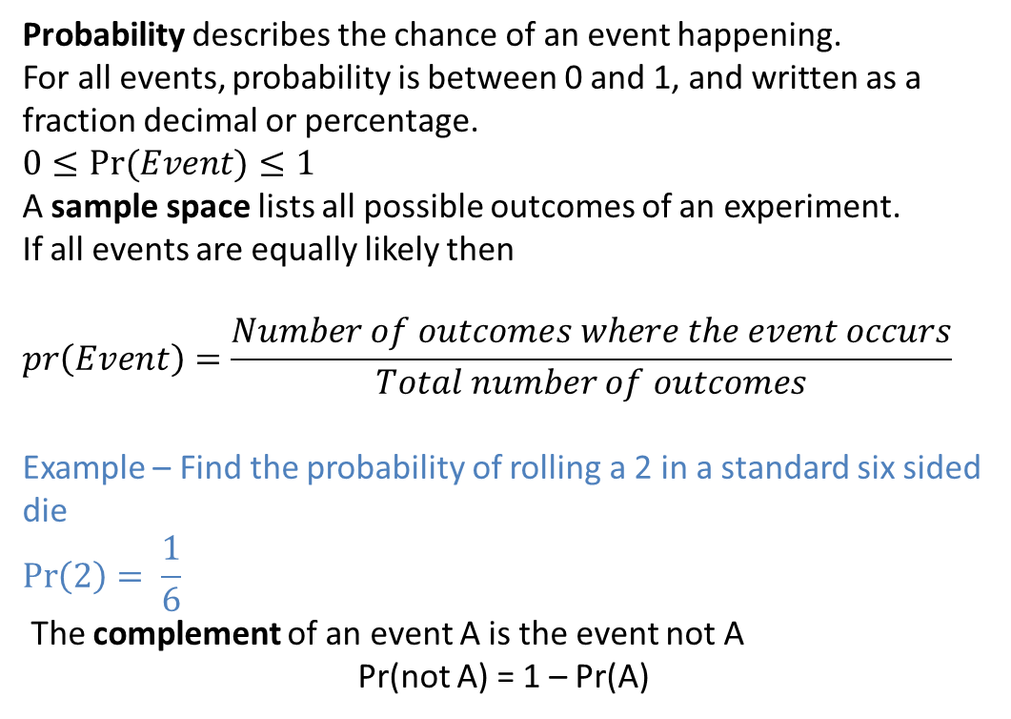
24
7
30
Date
Probability Revision
EQ – Describe how a sample space is used to calculate the probability of an even happening.
Probability describes the chance of an event happening.
For all events, probability is between 0 and 1, and written as a fraction decimal or percentage.
$$0≤Pr⁡(Event)≤1$$
A sample space lists all possible outcomes of an experiment.
If all events are equally likely then
$$pr\left(Event\right)=\frac{Number of outcomes where the event occurs}{Total number of outcomes}$$
Example – Find the probability of rolling a 2 in a standard six sided die
$$\operatorname{Pr}\left(2\right)= \frac{1}{6}$$
The complement of an event A is the event not A
Pr(not A) = 1 – Pr(A)
5

Slide 13
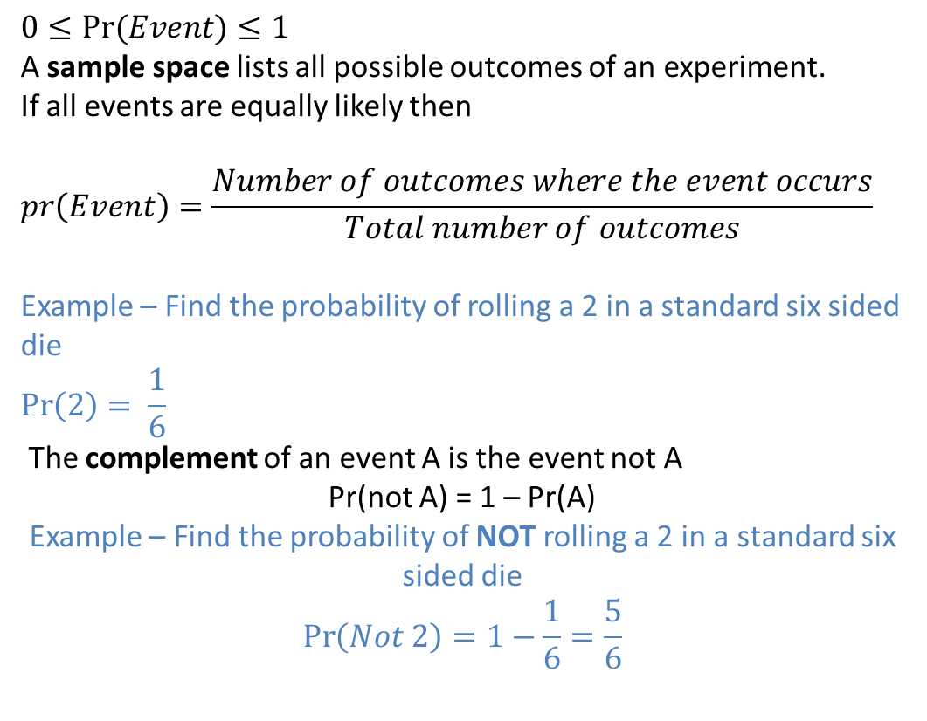
24
7
30
Date
Probability Revision
EQ – Describe how a sample space is used to calculate the probability of an even happening.
$$0≤Pr⁡(Event)≤1$$
A sample space lists all possible outcomes of an experiment.
If all events are equally likely then
$$pr\left(Event\right)=\frac{Number of outcomes where the event occurs}{Total number of outcomes}$$
Example – Find the probability of rolling a 2 in a standard six sided die
$$\operatorname{Pr}\left(2\right)= \frac{1}{6}$$
The complement of an event A is the event not A
Pr(not A) = 1 – Pr(A)
Example – Find the probability of NOT rolling a 2 in a standard six sided die
$$\operatorname{Pr}\left(Not 2\right)=1−\frac{1}{6}=\frac{5}{6}$$
5

Slide 14
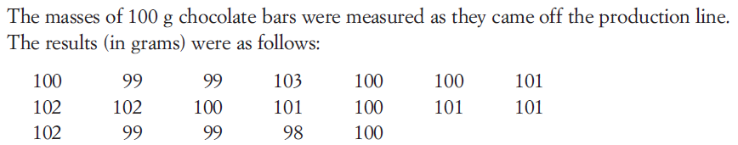
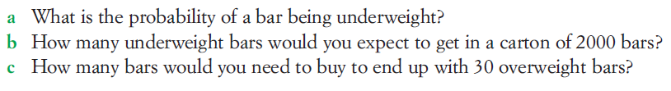
24
7
30
Date
Probability Revision
EQ – Describe how a sample space is used to calculate the probability of an even happening.
Example.
5

Slide 15
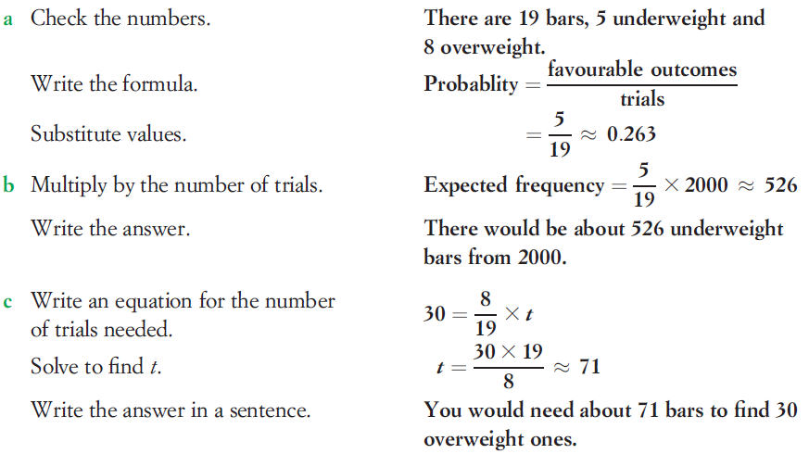
24
7
30
Date
Probability Revision
EQ – Describe how a sample space is used to calculate the probability of an even happening.
Example.
Solution.
5

Slide 16
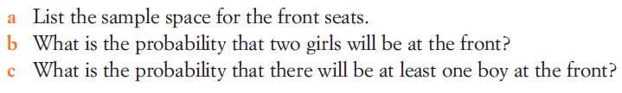
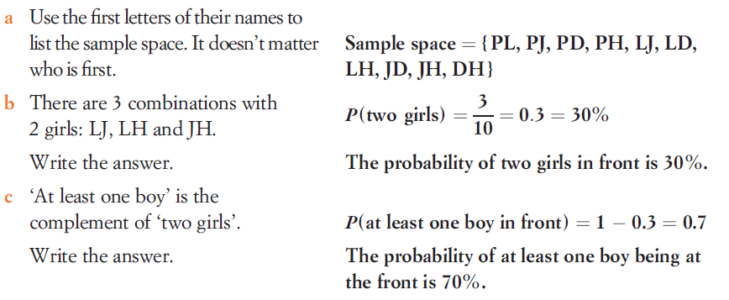
24
7
30
Date
Probability Revision
EQ – Describe how a sample space is used to calculate the probability of an even happening.
Example.
Solution.
5

Slide 17
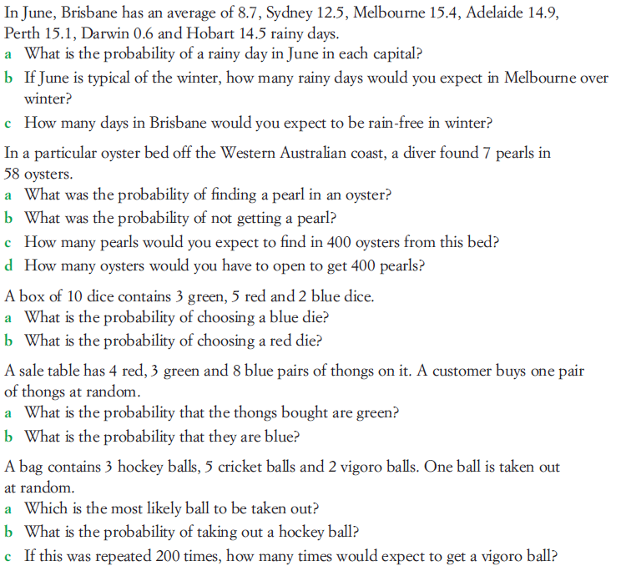
Task

Slide 18
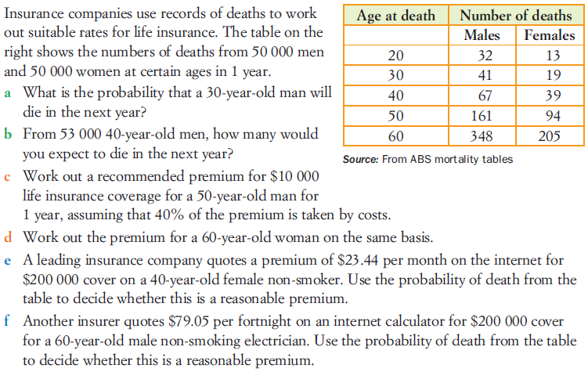
Task

Slide 19
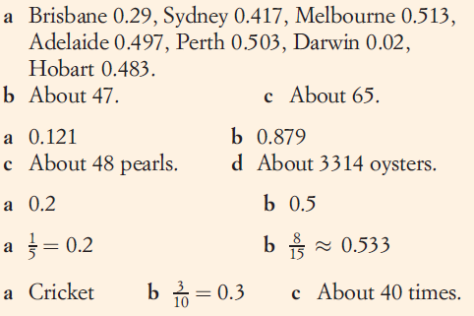
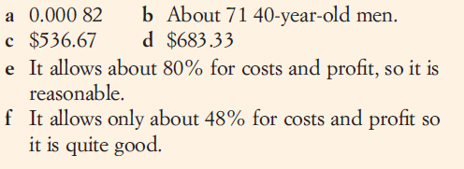
Answers

Slide 20
Plenary
http://www.mymathsonline.com.au/gold/playyourcards/playcards.swf

Slide 21
Notes Review
24, 7 ,30
Date
Title
Essential question
Notes complete
Notes complete with colour and diagrams
Questions completed
Contents page filed in
Formula page filled in

Slide 22
Homework
Review your notes and write a summary answering the essential question.

